Slide 1
FOR FLOWCHARTS AND DATA FLOW DIAGRAMS
ONLINE DIAGRAMMATIC TOOL
TEAM MEMBERS :
KAIPU SURYA PRATHAP REDDY - 19BCE0211
PEDDAKOTLA MOHIT SAI KRISHNA - 19BCE0431
VISHAKA MOHAN - 19BCE00193

Slide 2

Objective:
This is a diagrammatic CASE tool which will help in graphical representations of the data and system processes.
It will act as a great tool for project management – to present the idea, keep the workflow or communication organized or mapping a product from conception to launch.
It will be a user-friendly software used for creating sequence diagrams of interconnected shapes that outlines the flow, hierarchy, order or structure of a plan or idea.
It will have an effective user interface with easy-to-use features.
More than one user can work on a document at the same time enabling easy real-time collaboration.
It will contain a wide variety of shapes, connectors and ready to use templates that can be edited according to the user’s choice along with formatting and design tools. Chats and comments feature should also be available for real-time communication.

Slide 3
SCOPE OF THE PROJECT :
PROJECT AIM -
The aim of the online diagrammatic tool is to allow the user to make flowcharts and diagrams easily using shapes and existing templates. More than one user will be allowed to work on a document at the same time allowing real-time collaboration. The document can be shared and exported in various formats as well. The UI of the website will be quite user-friendly with easy-to-use features.
PROJECT GOAL -
The online cater to the needs of the end-users who are mostly students – using for school/university assignments or project managers in software companies – to be used for various project management and planning tasks.

Slide 4
SCOPE OF THE PROJECT :
MILESTONES-
Milestone | Date of Completion
Requirement analysis and planning | 3 March, 2021
Designing the website layout | 8 March, 2021
Shapes + templates + formatting tools | 20 March, 2021
Chat and comment section + real-time collaboration | 28 March, 2021
Making components functional and integration of the components | 13 April, 2021
Deployment and maintenance | 15 April, 2021
DELIVERABLES-
Deliverable | Date of Completion
Software requirement specification document | 4 March, 2021
Design prototype | 21 March, 2021
Final website | 16 April, 2021

Slide 5
System model
The project model most suitable for our project is the Waterfall model. Our project requires the implementation of the features listed above. Hence, the exact features that we wish to incorporate in the final product are clear and are not likely to be changed in the future. Therefore, we feel it is better to freeze the requirements at the start itself and have a clear plan about what we’re trying to build since it is a short project and the team is not too big as well.
Reasons to choose Waterfall model:
The flowchart diagrammatic tool is a short project and the cost is low.
No ambiguity in requirements. The diagrammatic tool is meant to have various shapes and connectors, templates for making diagrams, real-time collaboration feature with chat and comments for communication among team members. These requirements are quite clear and are in no way ambiguous.
The above requirements are also fixed and are not likely to change for a short project like this one.
Risk is zero.
The technology to be used is well understood. We plan to make a web application where the tech stack is HTML/CSS/JavaScript for the frontend Node.js for the backend and MongoDB database for storing user data.
It will be easier to manage and arrange the tasks since the team is small and the various components for this project are somewhat independent so different people can work on it and later integrate all the modules.
Thus, it is quite systematic for our project and the process and results will be well documented.

Slide 6
System architecture
Client-server architecture is appropriate for the online diagrammatic tool because we will deliver the product as a web-based application. The different functionalities of the diagrammatic tool can be handled by different servers and control can be established among them via the network. There will also be a database on the cloud where the details and files of the registered users will be stored. The users can request for their saved documents from the server at any time – the server will fetch the required user data from the database. The online diagrammatic tool will also enable users to collaborate in real-time providing chat facility – hence sockets have to be used. Thus, client-server architecture seems to be apt for the online diagrammatic tool project.

Slide 7
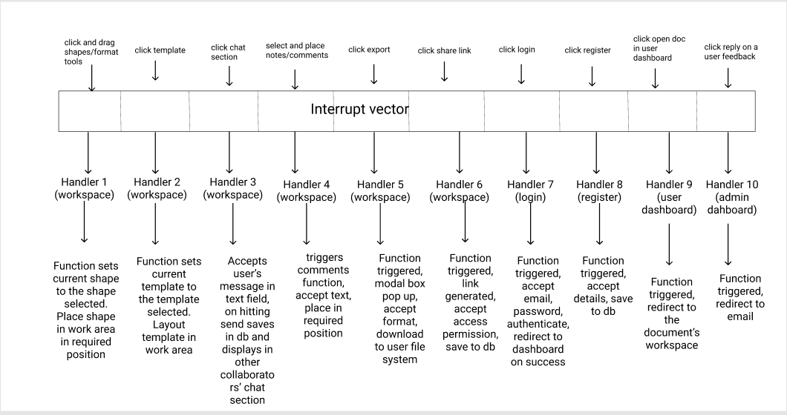
Control model
- Event-based control seems to be apt for the online diagrammatic tool project because it is more of a real-time system where user events need to be handled (like click and activate shapes, drag and drop, etc.) .
Interrupt driven model should be appropriate – as a particular event is encountered, the handler responsible for that event should respond and take necessary actions to execute the function that is triggered by that event.
For example: On clicking a shape – function is fired to set the current active element to be the currently selected shape. Similarly for mouse drag event, key press event, etc.

Slide 8
STAKE HOLDERS :
Customers/users – the diagrammatic tool is to be used by customers for their own purposes.
Project manager – the project manager plans out the schedule of the project and divide work among all the team members using flowcharts, timeline charts and gantt charts. Only professional users can unlock certain templates.
Design team – to design the layout of the website and its various components.
Technical team – to implement all the above-listed features in accordance with the design by the design team
Software testing team – to test the tool and find the possible bugs and defects.
Quality Assurance team – to ensure that the diagrammatic tool corresponds to all the specifications and requirements by the customer as listed above.
Project sponsors – the financier of the project

Slide 9
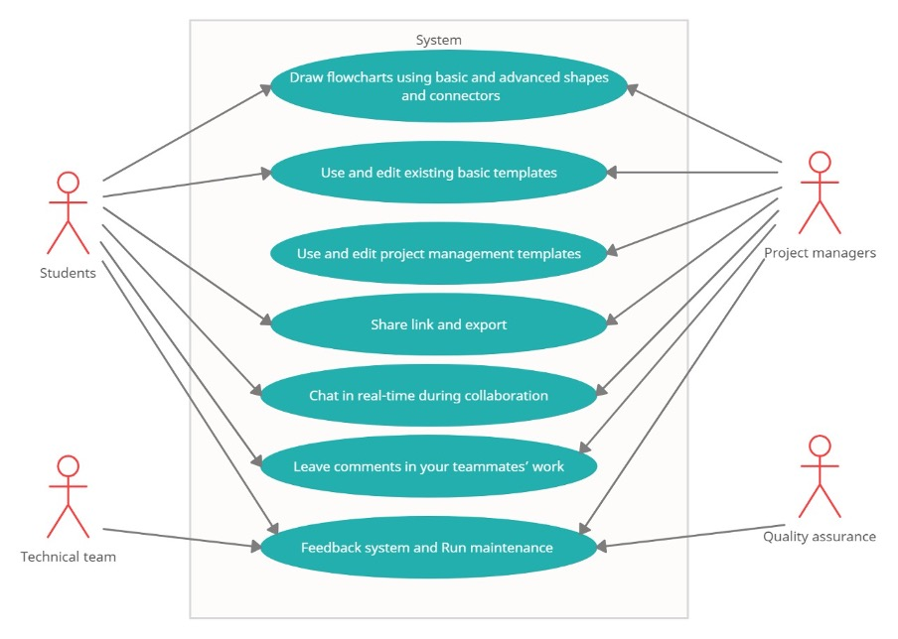
USE CASE DIAGRAM :
ACTORS :
Student Users
Project manager (Professional users)
Technical team
Quality assurance team
USECASES :
Draw flowcharts using basic and advanced shapes and connectors
Use and edit existing basic templates
Use and edit existing project management templates (only for professional user)
Share link and export
Chat in real-time during collaboration
Leave comments in your teammates work
Feedback system and run maintenance

Slide 10
Technical specifications and technology stack
Frontend:
HTML
CSS
Javascript
jQuery – a JavaScript library for DOM manipulation with event handling support
Bootstrap – a CSS framework with templates to build responsive websites
Fabric.js – a JavaScript HTML5 canvas library which provides interactive components like shapes, text boxes, etc. (used to build the main canvas workspace)
Figma – a vector graphics editor used to build design prototypes

Slide 11
Backend:
To build the backend and interacting with database:
Node.js – a backend JavaScript runtime environment that runs on V8 engine and executes JavaScript code outside a web browser.
Express.js – backend web application framework for Node.js server side development.
Socket.io – server side JavaScript library realtime bidirectional communication between web clients (here, used for realtime collaboration and chat)
JSON Web Token (jwt) – for digital signatures – used in authentication module
MongoDB Cloud – NoSQL database which uses JSON-like documents with optional schemas – to store all the user information and documents
Mongoose js – an Object Data Modeling (ODM) library for MongoDB and Node.js
Bcrypt – hashing library to hash passwords before storing in the database
Embedded JavaScript (ejs) – templating engine used to generate HTML with JavaScript code embedded.

Slide 12
Hardware specifications:
Processor – Intel or AMD processor with 32 bit support. Minimum 1GHz; 2 GHz or more is recommended
Disk storage – 1 GB of free space
Memory (RAM) – Minimum 1 GB; Recommended 4 GB or more
Ethernet connection (LAN) or a wireless adapter (Wi-Fi)
Monitor resolution: 1280 x 800; recommended 1920x1080
Software requirements:
Operating system – Windows 7 or above/ OSX/ Linux
Node.js – version 14.17.0
Node package manager – npm (installed with Node.js)

Slide 13
RESULT AND DISCUSSION
The cost that we spent on the project was zero, since we’ve used such resources that are freely available on internet. Some of them like mongodb cloud storage, which let us to have a limited free storage for this project, but in the future if we want to scale up our project, then we should have to purchase more storage capacity.
In the future, we’ll try to include the todo list option into our project, where user is allowed to have a list of things he need to-do, that prioritize the tasks on it.
We plan to include some ready to use templates in the future.
Otherwise, 90% of the features were implemented according to specifications and design and seem to be working smoothly as verified in the test report.

Slide 14
THANK YOU

